Slide 1


Survey Design
Chapter 12

Slide 2

Survey Designs: What is it?
Most people are familiar with surveys- you are asked to do them many times!
Useful in quantitative and qualitative research in order to analyze the trends/responses
Surveys help to identify important beliefs and attitudes of individuals, and provide useful information to evaluate from
The first early surveys date back to 1817, however, now guidelines help us to write clear questions to allow for consistency
Many different types of survey designs (cross-sectional, longitudinal, sampling from a population, questionnaires and interviews, etc)

Slide 3
Questionnaires and Interviews (p. 385)
Survey researchers typically collect data using either questionnaires or interviews.
Questionnaire: form used in a survey design that participants in a study complete and return to the researcher
Interview survey: form on which the researcher records answers supplied by the participant in the study.
Quantitative survey interviews- investigator uses structured and mostly closed- ended questions
Qualitative survey interviews- interviewer asks open ended questions without response options and listen and records the comments of the interviewee.

Slide 4
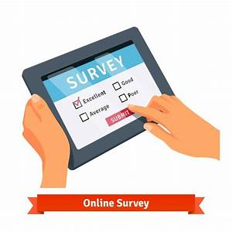
Major types of survey research
Mailed questionnaires
Web-based questionnaires
Telephone interviews
One-on-one interviews
Focus group interviews

Slide 5

Focus Group Interviews
A focus group interview is a tool for qualitative market research where a group of people are selected and asked about their opinion or perceptions about a particular topic. The environment is interactive where the participants are free to discuss with each other.
There is a trained moderator and a small group of respondents
Participants are normally similar in terms or either demographics or psychographics or buying behaviour/attitudes
Participants are unknown to each other
(from: https://www.mbaskool.com/business-concepts/marketing-and-strategy-terms/12024-focus-group-interview.html)
https://www.youtube.com/watch?v=3TwgVQIZPsw

Slide 6

Survey Instrument Design
When writing good survey questions, researchers typically follow the following steps:
They write different types of questions
They use strategies for good question construction
They perform a pilot test of the questions

Slide 7

Survey Questions- The 7 Different Types

Slide 8
1. Personal Questions
Definition: background or demographic questions
Questions that assess the personal characteristics of people in your sample

Slide 9
Examples of Personal Questions
What is your age?
How many years of teaching have you completed (end of school year)?
Do you identify as male, female, transgender, gender fluid, non-binary other?
Do you identify as heterosexual/straight, homosexual, bisexual, prefer not to answer?

Slide 10
Personal Questions
Example:
How much do you agree or disagree with this statement:
I would describe my nationality as Canadian.
______ strongly agree
______ agree
______ neither agree nor disagree
______ disagree
______ strongly disagree
Example:
How much do you agree or disagree with this statement:
Most days I am enthusiastic about being a student.
______ strongly agree
______ agree
______ neither agree nor disagree
______ disagree
______ strongly disagree

Slide 11
2. Behavioural Questions
Definition: questions that can solicit information about the actual behaviour of individuals in the sample.

Slide 12
Behavioural Questions
Example:
Did you take a semester off during any of your 2 years of college?
____ yes
____ no
Example:
Have you travelled outside of Canada in the past 5 years?
____ yes
____ no

Slide 13
3. Attitudinal Questions
Definition: provides information on emotions, feelings and attitudes of the individual and how they perceive things.
Example:
How do you feel about the current homelessness crisis?
____ Indifferent
_____ Uncomfortable

Slide 14
4. Sensitive Questions
Some surveys contain sensitive questions that must be developed and used with care
Sensitive questions might involve the following topics:
Drug and alcohol use
Mental health issues
Abuse or mistreatment
Gun laws
Abortion laws

Slide 15
Sensitive Questions and the Use of Lead-Ins
Initial comments can also lead the respondent into the question.
Example:
Instead of: Have you ever used illegal drugs?
Try: In past surveys, many men have reported that at some point in their lives they have used illegal drugs. This could have happened before adolescence, during adolescence, or as an adult. Have you ever used illegal drugs?

Slide 16
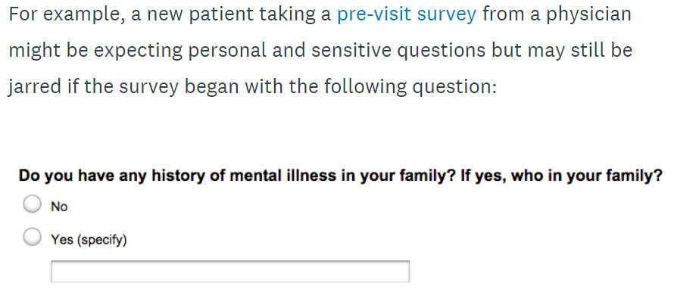
Sensitive Question Example:
A patient is going to a new doctor for the first time and is required to take a pre-visit survey. The patient might be expecting to answer some personal and sensitive questions but might be taken by surprise if the first question starts off with:

Slide 17
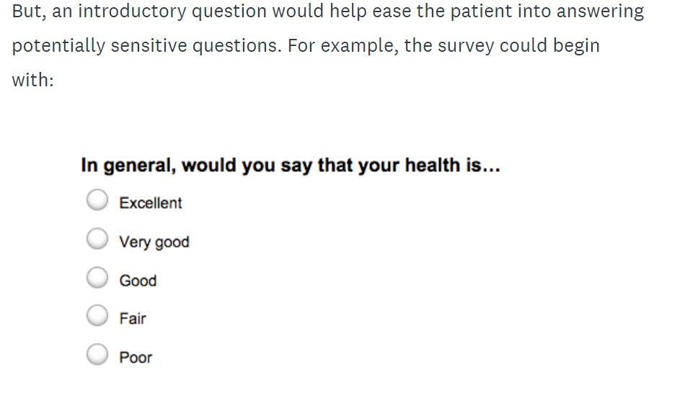
So, if the survey provides an introductory question, it helps ease the patient into answering potentially sensitive questions.
For example:

Slide 18
Why are Sensitive Questions so Difficult?
People are uncomfortable giving out sensitive information…even if it is anonymous
They may not know who you are, or what the results of the survey will be used for
Most people do not like to answer sensitive questions…therefore people may either:
Skip the question
Not complete the survey

Slide 19
5. Closed-Ended Questions
The researcher poses a question and provides preset response options for the participant
Benefits:
easily comparable responses
useful for sensitive questions because participants might feel more comfortable knowing the parameters of responses

Slide 20
Example:
There are many reasons why adults wish to get more education. What is the most important reason to you for coming to adult basic education classes? (check one).
_____ to be able to help my children with their schoolwork
_____ to get a better job
_____ to improve myself
_____ to get a high school equivalence diploma

Slide 21
6. Open-Ended Questions
Questions in which researchers do not provide response options
Used for digging deeper-exploring many possibilities that individuals might create for a question.
Ideal when a researcher does not know the response possibilities and wants to explore possible options.
Drawback?
Harder to categorize into themes

Slide 22
Example
Why are you attending adult education classes?
____________________________________________________________________________________________________________________

Slide 23
7. Semi-Closed Questions
Has advantages of both open and closed-ended questions
The technique is to ask a closed-ended question and then ask for additional responses in an open-ended question
Allows respondent to write in an answer if theirs doesn’t fit within the response choices

Slide 24
Example
There are many reasons why adults wish to get more education. What is your most important reason for coming to adult basic education classes? (check one).
_____ to be able to help my children with their schoolwork
_____ to get a better job
_____ to improve myself
_____ to get a high school equivalence diploma
_____ Other (please comment) _________________________

Slide 25
Two Types of Survey Questions in One?
Is it possible to have 2 different types of questions in one?
YES
For example, a survey question you design could be both attitudinal and sensitive!

Slide 26
Question Construction
Pay attention to the quality of the question.
Using good questions help participants feel that they understand the question and can provide meaningful answers.
Good questions are clear and do not confuse participant
They show respect to participants by being sensitive to gender, class, and needs
When you construct questions, fit the questions to the answers, include suitable response options, and do not overlap (can be confusing to respondents)

Slide 27

Testing The Questions
Helps to identify if all individuals can complete the survey and understand the questions
Participants typically include written comments directly on the survey, and the researcher modifies or changes the survey to reflect those concerns

Slide 28
Poor & Improved Questions
Review Table 12.1 – p. 397 for a chart outlining differences in poor and improved questions for a survey.

